Slide 1
ARTIFICIAL General INTELLIGENCE
Exploring the Potential, Challenges, and Economic Impact
Bharath K
23BCAR0252

Slide 2






What is Artificial General Intelligence?
AGI (Artificial General Intelligence) refers to a type of artificial intelligence that is capable of understanding, learning, and applying knowledge across a broad range of tasks at a level comparable to human intelligence. Unlike Narrow AI (ANI), which is specialized and limited to specific tasks, AGI aims to possess the versatility and cognitive abilities to perform any intellectual task that a human can, including reasoning, problem-solving, and adapting to new situations.

Slide 3
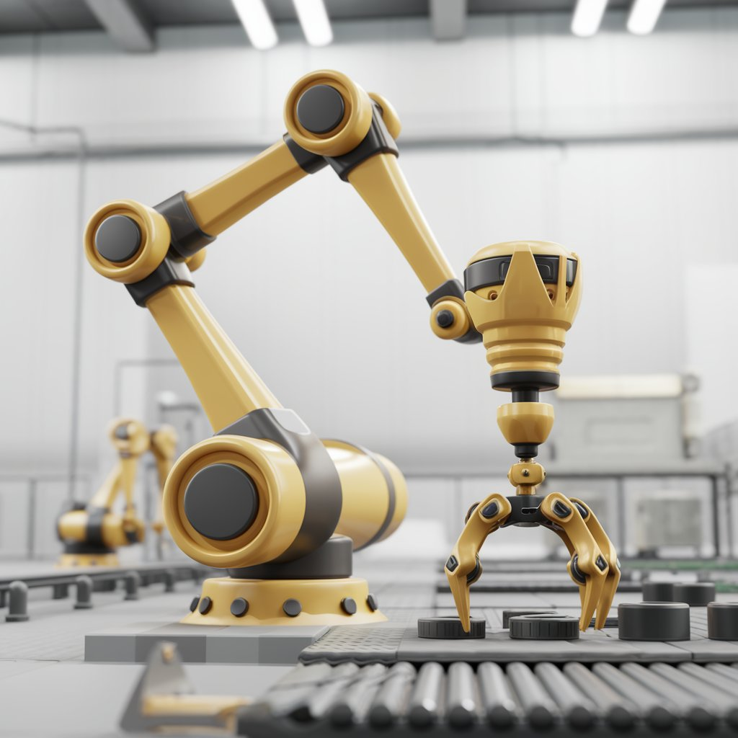
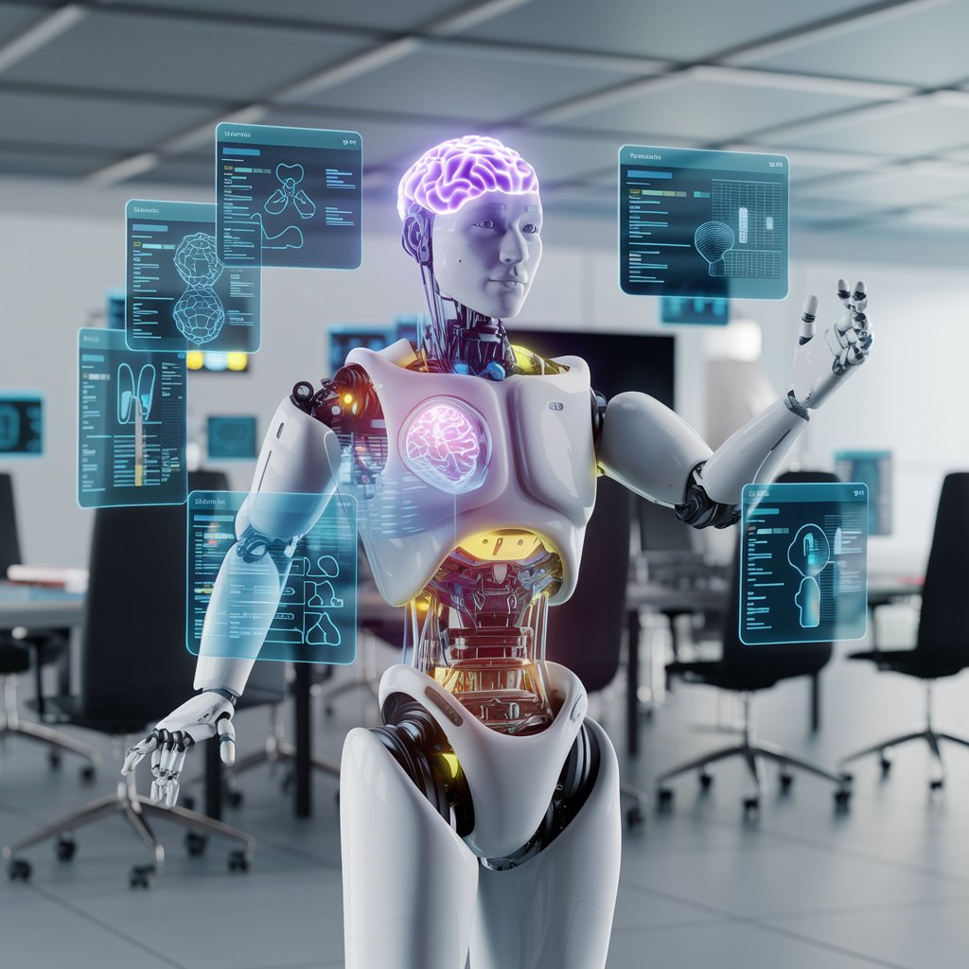
ANI [Narrow Intelligence]
AGI [General intelligence]
Narrow Focus
Learns for One task
Widely Used Today
Task Specific Intelligence
Limited Flexibility
Broad Scope
Learns Across Fields
Not Achived Yet
Human Like Understanding
Adaptable to New Situations

Slide 4
Historical Context
01.
02.
03.
Turing’s Vision (1950)
Dartmouth Conference (1956)
Symbolic AI Era (1960s-70s)
04.
05.
06.
Machine Learning Rise (1980s-90s)
Deep Learning Breakthrough (2000s)
AGI Research Focus (Present)
Proposed machines could exhibit intelligent behavior.
Formalized AI research; coined "Artificial Intelligence."
Used rule-based logic for problem-solving.
Enabled learning from data for improvement.
Revolutionized AI with neural networks.
Aims to develop human-like cognitive abilities.

Slide 5


Key Characteristics of AGI
Ability to apply knowledge and skills across diverse tasks and situations beyond specific training.
Generalization
Capability to perform tasks and make decisions independently, without requiring constant human guidance.
Autonomy

Slide 6


Potential Advantages of AGI
Innovation
Efficiency
Personalization
AGI could drive groundbreaking advancements in science and technology by solving complex problems and generating new ideas.
It has the potential to significantly enhance productivity by automating diverse tasks and optimizing processes.
AGI could offer highly tailored experiences and solutions, adapting to individual needs and preferences more effectively.

Slide 7



Potential Disadvantages of AGI
Job Displacement
Ethical Concerns
Existential Risk
The development of AGI raises complex ethical issues, including decision-making and control over powerful autonomous systems.
AGI could lead to significant unemployment by automating tasks currently performed by humans.
If not properly managed, AGI could pose serious risks to humanity's safety and security, including unintended consequences and loss of control.

Slide 8
—Ray Kurzweil
“AGI will revolutionize industries and accelerate innovation. This will lead to significant economic growth but also require us to navigate new challenges.”

Slide 9



Environmental Concerns Related to AGI
Energy
Emissions
Waste
AGI models require immense computational power, leading to high energy consumption. For instance, training a large AI model can use as much electricity as an average household does in several days.
The rapid advancement in AGI technology contributes to increasing electronic waste from outdated hardware. Improper disposal of this e-waste can lead to environmental pollution and resource depletion.
The process of training and running AGI systems generates significant carbon dioxide emissions. This can result in up to 626,000 pounds of CO2, equivalent to the lifetime emissions of multiple cars.

Slide 11






Real-World Applications
Healthcare
Finance
Education
Transportation
Customer Service
Research
AGI could improve diagnostics and personalized treatment.
AGI could optimize trading strategies and detect fraud.
AGI could personalize learning and adaptive tutoring.
AGI could enhance autonomous driving and logistics.
AGI could manage complex customer inquiries efficiently.
AGI could accelerate scientific discoveries and innovation.

Slide 12





Challenges in Achieving AGI
Computation
Understanding
Achieving AGI requires immense computational power and resources.
Replicating human-level understanding in machines remains highly complex.
Adaptability
Ethics
Safety
AGI must adapt to new situations without retraining, a major challenge.
Defining ethical guidelines for AGI development is still unresolved.
Ensuring AGI behaves safely in unpredictable scenarios is critical.

Slide 13
What Lies Ahead for AGI
Economical Transformation
Scientific Breakthroughs
Ethical Challenges
Human-AI Symbiosis
AGI will automate complex tasks, causing job displacement and industry transformation across sectors.
AGI will accelerate breakthroughs in science, medicine, and technology, leading to rapid innovation.
Society will face new ethical dilemmas around AGI control, safety, and fairness, requiring global regulation.
Humans and AGI will work together, enhancing creativity and productivity through advanced human-AI partnerships.

Slide 14



Staying Relevant in the Age of AGI
Creativity
Empathy
Collaboration
Humans can innovate and imagine in ways AGI cannot replicate.
Emotional intelligence and interpersonal skills remain uniquely human.
Partnering with AGI enhances productivity and problem-solving.

Slide 15


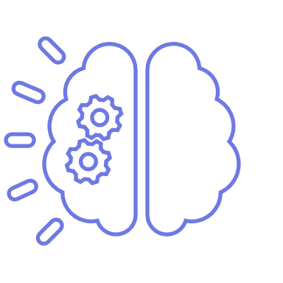






Thank You!

